Slide 1


Slide 2

Simplification of CFGs
  Killing Λ-Productions
  Killing unit-productions
  Removing Useless Variables
    Symbols & Productions
  Augmented Grammar

Slide 3

Λ-Productions:
In a given CFG, we call a non-terminal N nullable
if there is a production N → Λ, or
there is a derivation that starts at N and lead to a Λ.
N ➔ ……… ➔ Λ
Λ-Productions are undesirable.
We can replace Λ-production with appropriate non-Λ productions.

Slide 4
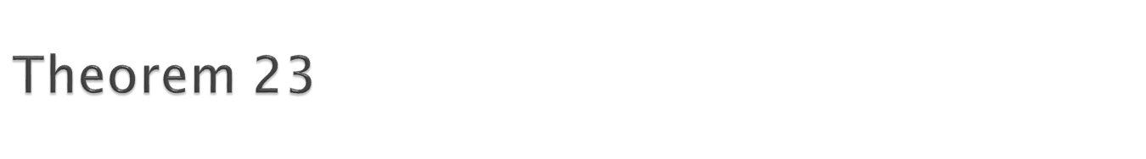
If L is CFL generated by a CFG having Λ-productions, then there is a different CFG that has no Λ-production and still generates either the whole language L (if L does not include Λ) or else generate the language of all the words in L other than Λ.
Replacement Rule.
Delete all Λ-Productions.
Add the following productions:
  For every production of the X → old string
  Add new production(s) of the form X → .., where right side will account for every modification of the old string that can be formed by deleting all possible subsets of null-able Non-Terminals, except that we do not allow X → Λ, to be formed if all the character in old string are null-able

Slide 5

Consider the CFG
S → a | Xb | aYa
X → Y | Λ
Y → b | X
X is nullable
Y is nullable
Old nullable New
Production Production
X → Y nothing
X → Λ nothing
Y → X nothing
S → Xb S → b
S → aYa S → aa
So the new CFG is
S → a | Xb | aa | aYa |b
X → Y
Y → b | X

Slide 6
Consider the CFG
S → Xa
X → aX | bX | Λ
X is nullable
Old nullable New
Production Production
S → Xa S → a
X → aX X → a
X → bX X → b
So the new CFG is
S → a | Xa
X → aX | bX | a | b

Slide 7
S → XY
X → Zb
Y → bW
Z → AB
W → Z
A → aA | bA | Λ
B → Ba | Bb | Λ
Null-able Non-terminals are?
A, B, Z and W

Slide 8

S → XY
X → Zb
Y → bW
Z → AB
W → Z
A → aA | bA | Λ
B → Ba | Bb | Λ
Old nullable New
Production Production
X → Zb X → b
Y → bW Y → b
Z → AB Z → A and
Z → B
W → Z Nothing new
A → aA A → a
A → bA A → b
B → Ba B →a
B → Bb B → b
So the new CFG is
S → XY
X → Zb | b
Y → bW | b
Z → AB | A | B
W → Z | B | A
A → aA | bA | a | b
B → Ba | Bb | a | b

Slide 9

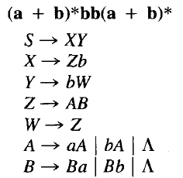
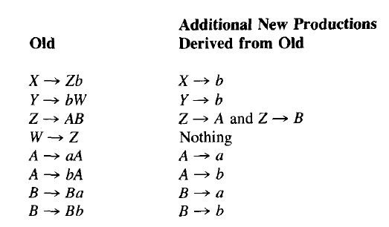

Slide 10
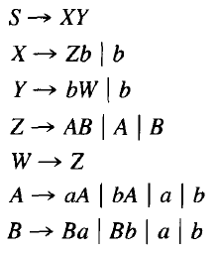

Slide 11

Definition: A production of the form
  non-terminal → one non-terminal
A →T
is called a unit production.
The following theorem allows us to get rid of unit productions:
Theorem 24:
If there is a CFG for the language L that has no Λ-productions, then there is also a CFG for L with no Λ-productions and no unit productions.

Slide 12

This is another proof by constructive algorithm.
Algorithm: For every pair of non-terminals A and B, if the CFG has a unit production A → B, or if there is a chain
A ➔ X₁ ➔ X₂ ➔ … ➔ B
where X₁, X₂, ... are non-terminals, create new productions as follows:
If the non-unit productions from B are
B → s₁ | s₂| …
where s₁, s₂, ... are strings, we create the productions
A → s₁| s₂| …

Slide 13
Consider the CFG
S → A| bb
A → B | b
B → S | a
The non-unit productions are
S → bb A → b B → a
And unit productions are
S → A
A → B
B → S

Slide 14

Let’s list all unit productions and their sequences and create new productions:
S → A gives S → b
S → A → B gives S → a
A → B gives A → a
A → B → S gives A → bb
B → S gives B → bb
B → S → A gives B → b
Eliminating all unit productions, the new CFG is
S → bb | b | a
A → b | a | bb
B → a | bb | b
This CFG generates a finite language since there are no non-terminals in any strings produced from S.
S → A| bb
A → B | b
B → S | a

Slide 15
Remove S → A
Values of A are B and b
Put A = b in above
S → A → b
Put A = B in above
S → A → B
Values OF B are S and a
Put B =a
S → A → B →a
Put B = S
S → A → B →S
Updated grammar
S → bb | b |a A → B | b B → S | a
S → A| bb
A → B | b
B → S | a
UNIT PRODUCTIONS
S → A
A → B
B → S
Theory of Automata
Oct 5, 2016

Slide 16
S → bb | b |a A → B | b B → S | a
Remove A → B
Vlues of B are S and a
Put B=a
A → B → a
Put B= S
A → B → S
PUT values of S in above
A → B → S→ bb | b |a
Updated grammar
S → bb | b |a A → b |a |bb B → S | a
Theory of Automata
Oct 5, 2016

Slide 17
S → bb | b | a
A → B | b B → S | a
Solve A → B
PUT B =a
A → B → a
A → a
Put B = S
A → B → S
A → B → S →bb | b | a
A→ a | bb|b
Update grammar
S → bb | b | a
A → bb| b |a B → S | a
Theory of Automata
Oct 5, 2016

Slide 18
S → bb | b | a
A → bb| b |a B → S | a
Remove B → S → bb | b | a
Updated grammar
S → bb | b | a
A → bb| b |a B → a |bb | b
Theory of Automata
Oct 5, 2016

Slide 19
Non Generating: production does not leads to strings of terminal symbols
Unreachable: which are not called by any production directly or indirectly.

Slide 20

PART1-Remove non generating
Identify variables that derive terminal strings
Remove non-terminals that do not derive terminal strings.
e.g. following grammar G = S → aS | A | C
A → a
B → aa
C → CB

Slide 21
S → aS | A | C
A → a
B → aa
C → CB
We can identify variables that derive terminal strings.
i.e. A → a B → aa
And S ➔A ➔ a TERM = {S, A, B}
But not C. thus C is useless
S → aS | A
A → a
B → aa

Slide 22
PART – II- Unreachable Production
Rename the grammar
GT = S → aS | A
A → a
B → aa
Now draw a graph and delete nodes not reachable from S.
As B is unreachable so delete it and the final grammar will be G_{V}=
S → aS | A
A → a
aa
a
S
A
B

Slide 23
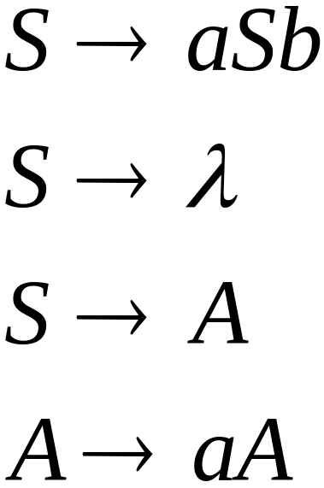
Useless Productions
Non Generating
Production
Some derivations never terminate...

Slide 24
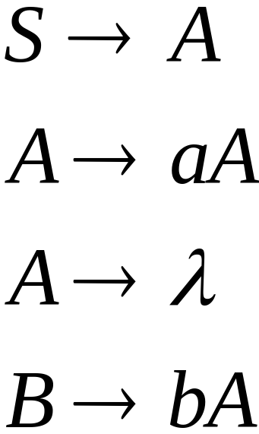
Another grammar:
Useless Production
Not reachable from S

Slide 25



In general:
if
and w contains only terminals
then variable is useful
otherwise, variable is useless

Slide 26

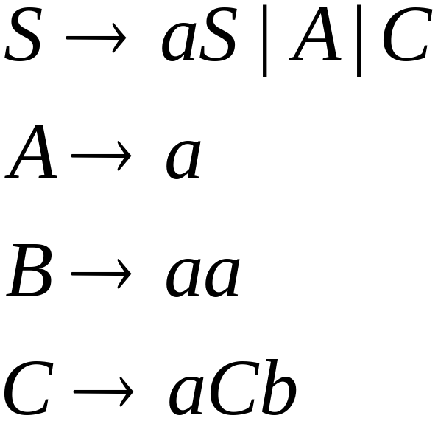
Example Grammar:

Slide 27
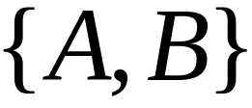

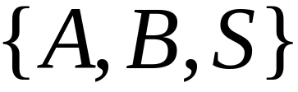
First:
find all variables that can produce
strings with only terminals
Round 1:
Round 2:

Slide 28
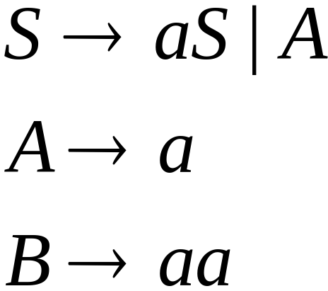
Keep only the variables
that produce terminal symbols:
(the rest variables are useless)
Remove useless productions

Slide 29




Second:
Find all variables
reachable from
Use a Dependency Graph
not
reachable

Slide 30
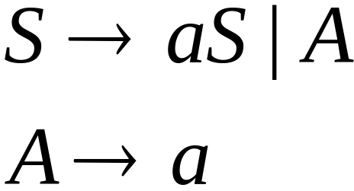
Keep only the variables
reachable from S
(the rest variables are useless)
Final Grammar
Remove useless productions

Slide 31
Consider following CFG
G: S → AC | BS | B
A → aA | aF
B → CF | b
C →cC | D
D →aD | BD | C
E → aA | BSA
F → bB | b
Remove Non generating
G_{T}:
S →BS | B
A → aA | aF
B → b
E → aA | BSA
F → bB | b
Remove Un reachable
G’_{T}:
S →BS | B
B → b

Slide 32

Step 1: Remove Nullable Variables
Step 2: Remove Unit-Productions
Step 3: Remove Useless Variables

Slide 33

S → AS | BS | B
Add a new start symbol S₀ S
This change guarantees that the start symbol of the new grammar will not occur on the rhs of any rule.
S₀ S
S → AS | BS | B

